Slide 1


Grafana Alerts: Powerful Notifications for Your Data
Grafana Alerts empower you to monitor your data effectively and proactively respond to critical changes. They send timely notifications when predefined thresholds are met, ensuring you stay informed and take action before issues escalate.
By :
Pushpa Boligarla
Sowmya Sudhakara
Abhishek Birtharey

Slide 2
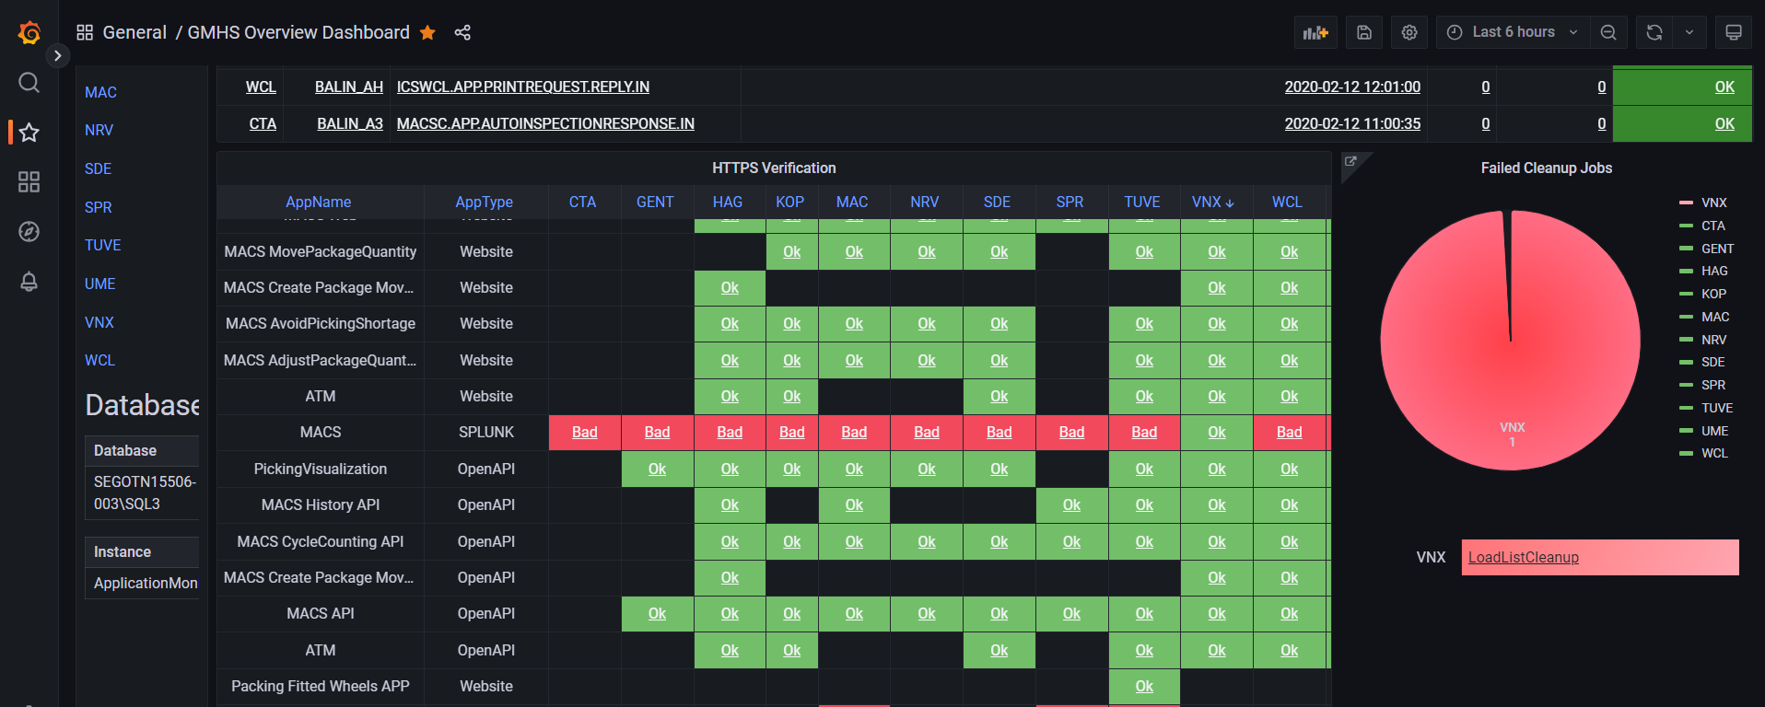
GHMS Application Monitor Dashboard

Slide 3


Configuring Grafana Alerts
1
Define Alert Rules
Set up specific criteria to trigger alerts, such as exceeding a threshold or detecting an anomaly in your data.
2
Select Notification Channels
Choose where you want to receive alerts, such as email, Slack, or webhooks.
3
Configure Alert Settings
Specify notification frequency, silence periods, and other parameters to customize how alerts are delivered.

Slide 4
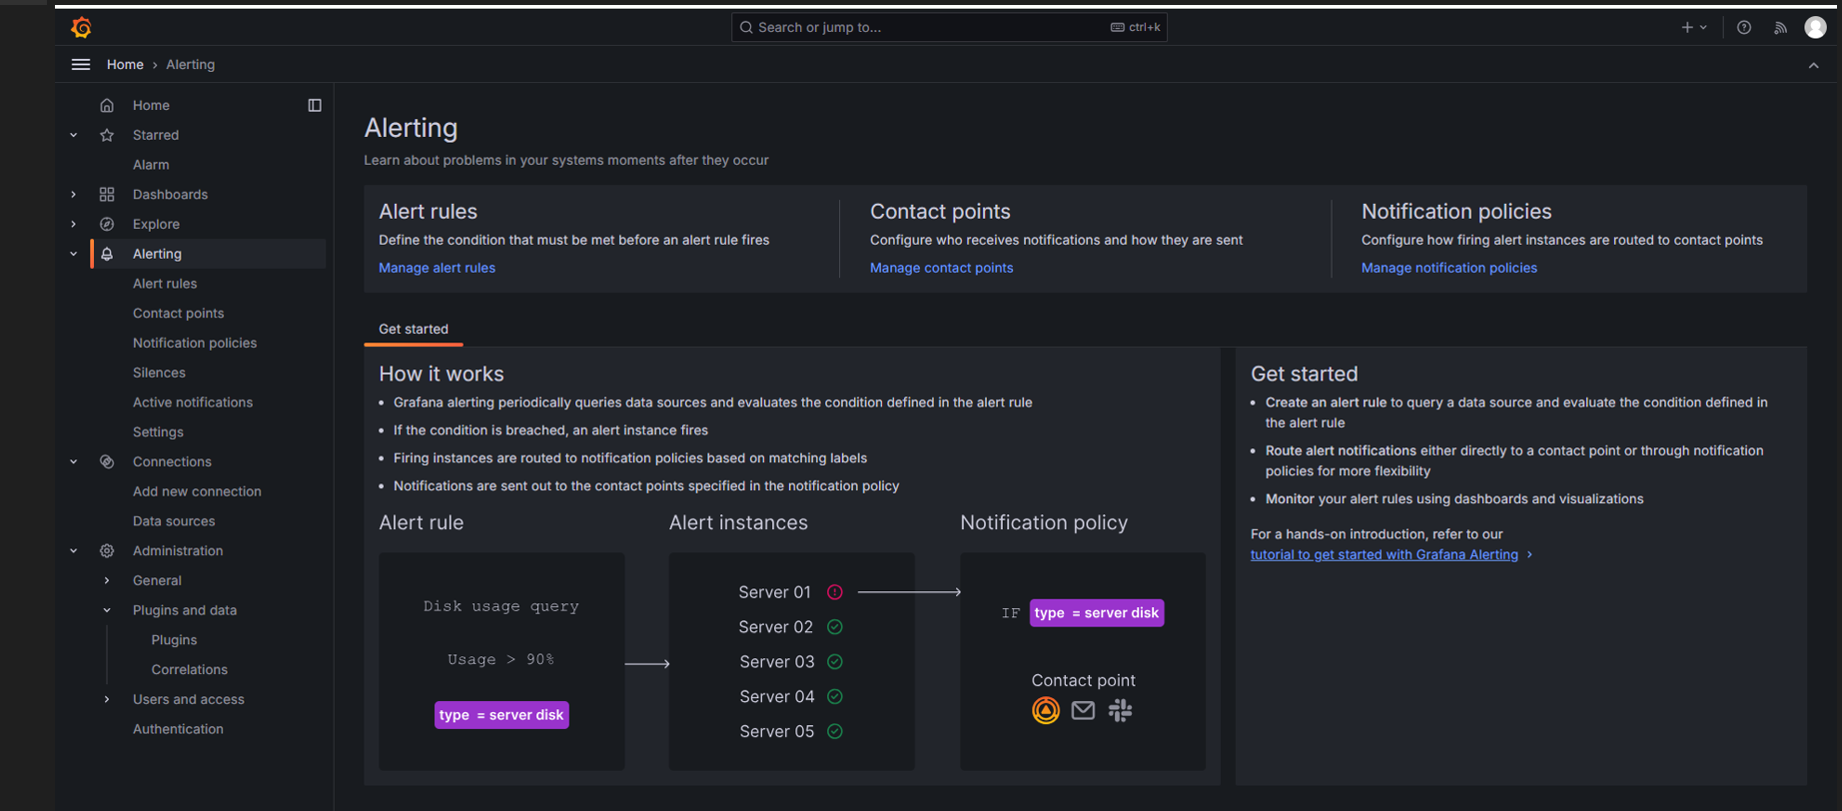
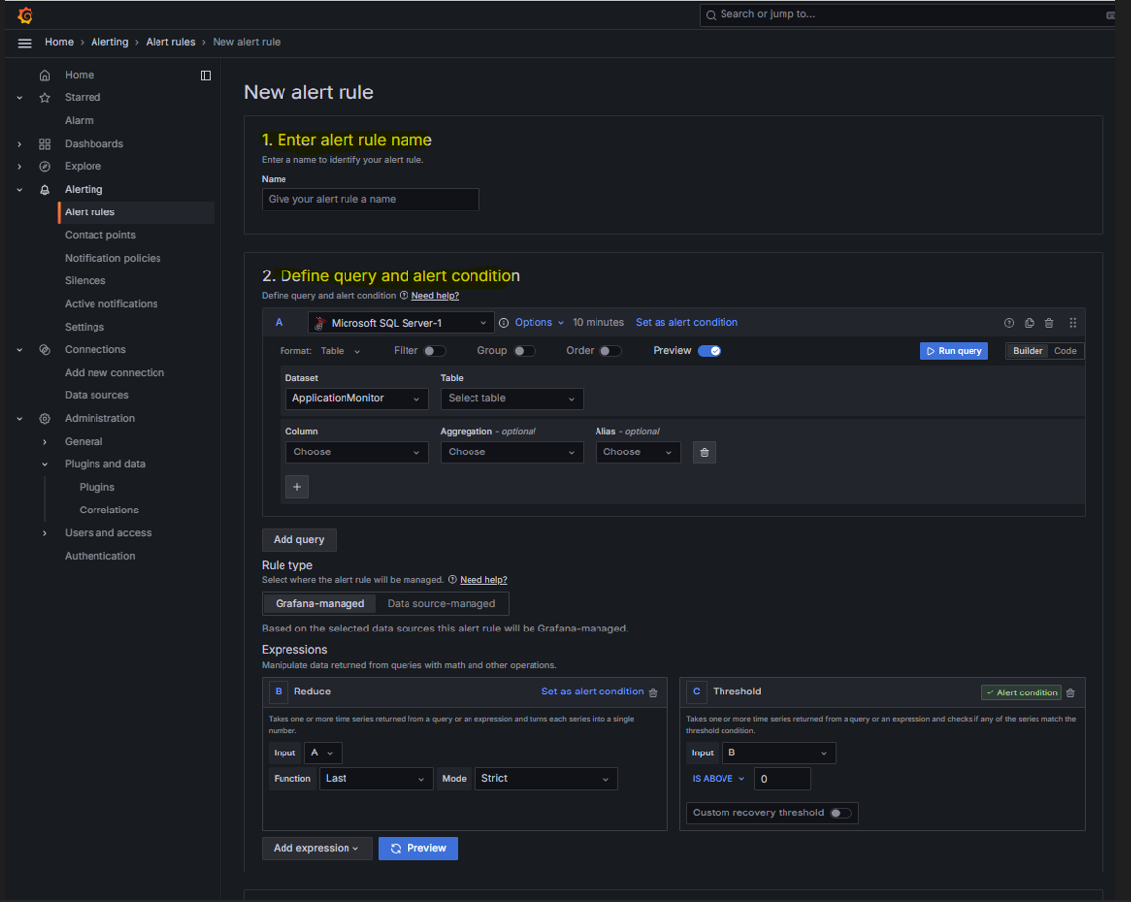
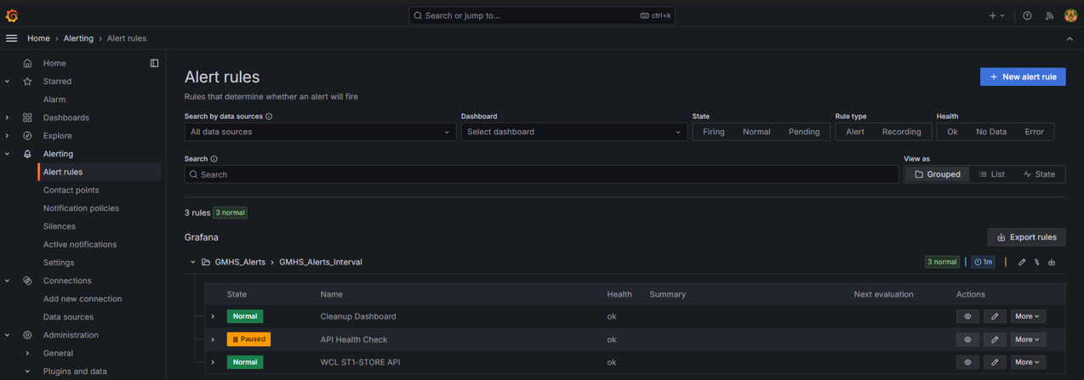
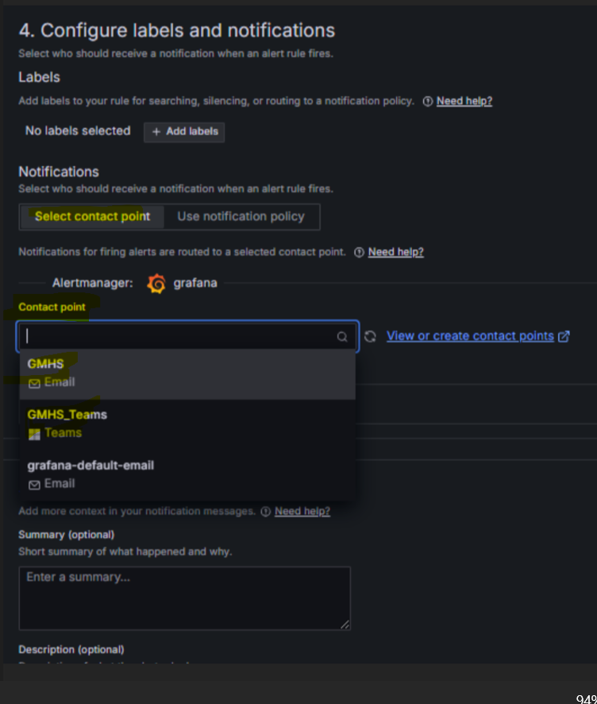

Slide 5

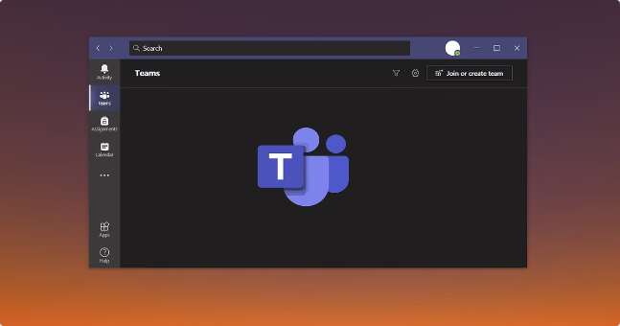
Contact Points Configuration

Slide 6
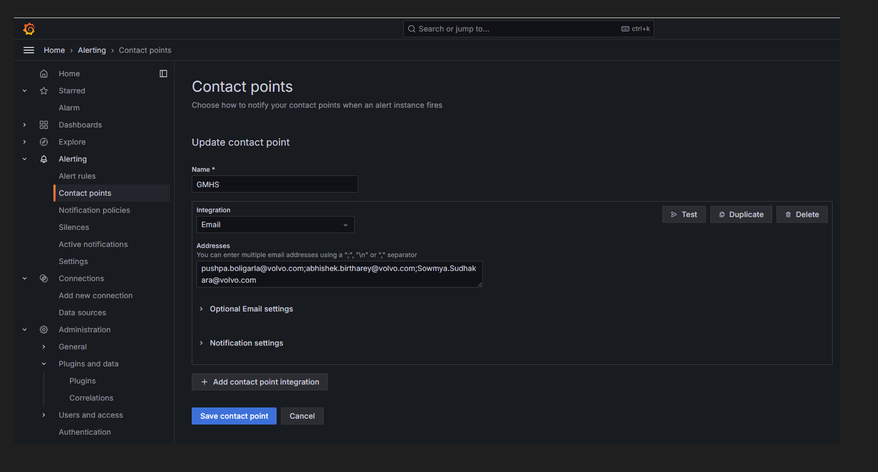
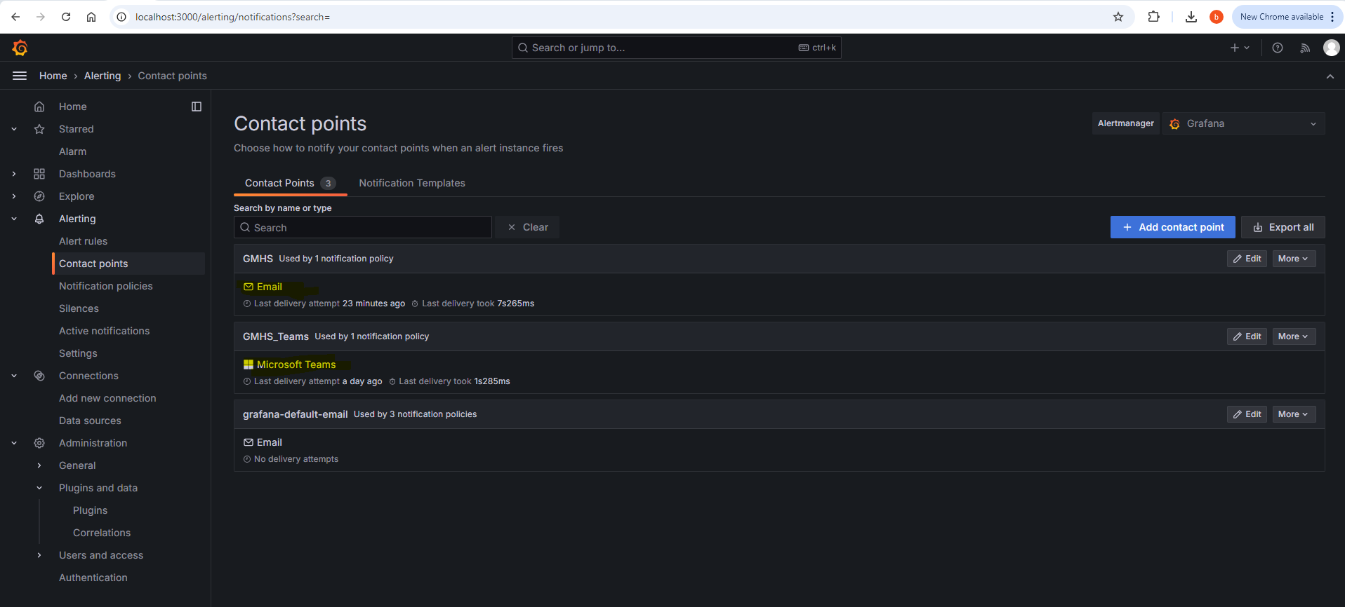
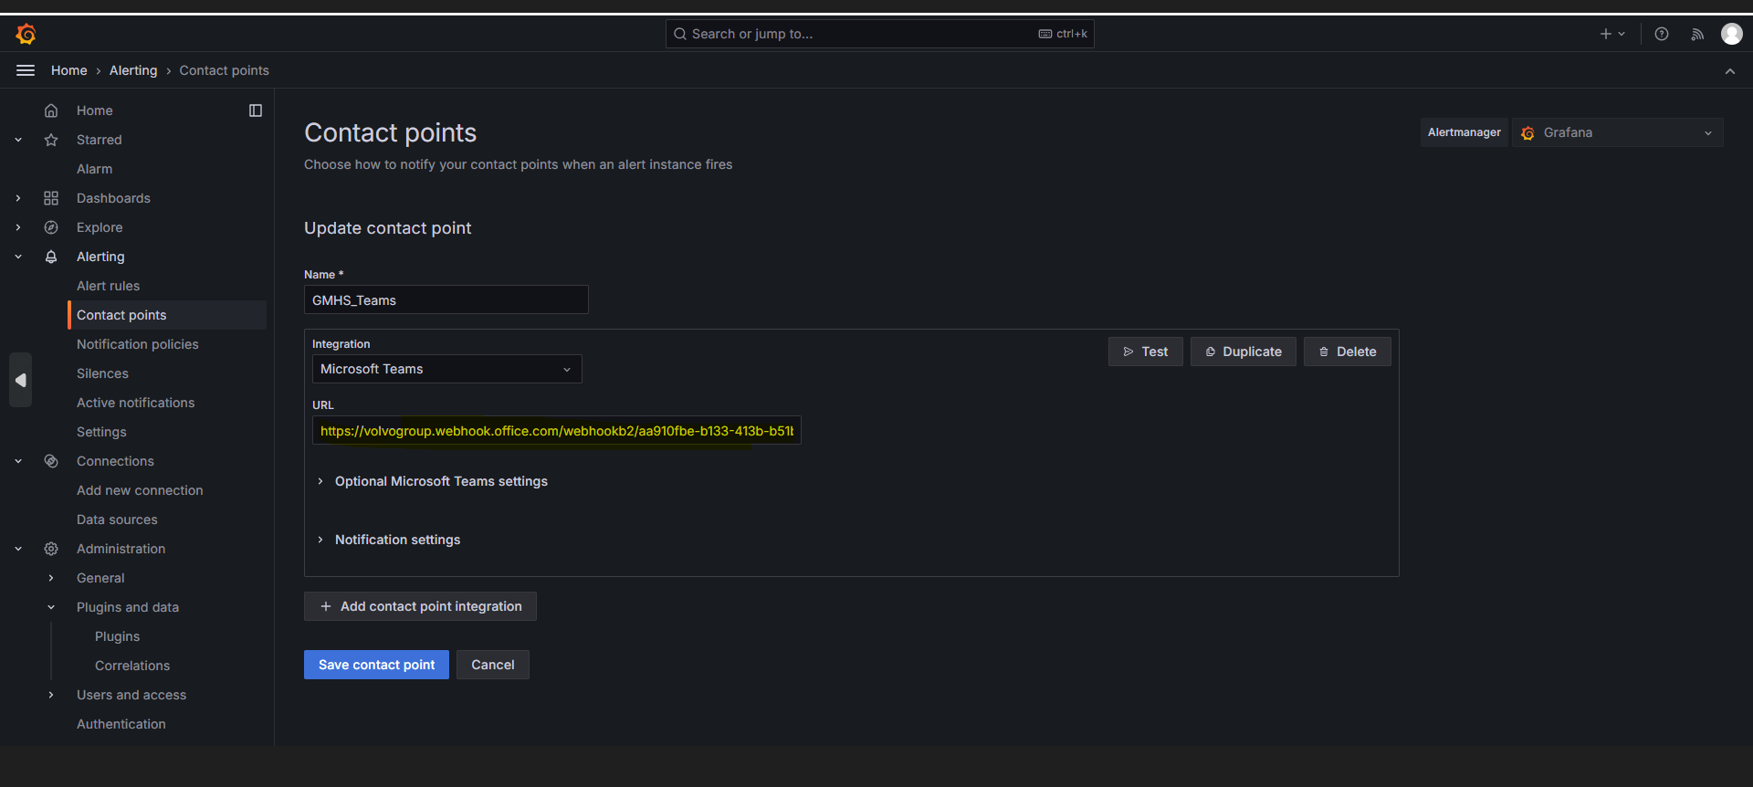

Slide 7
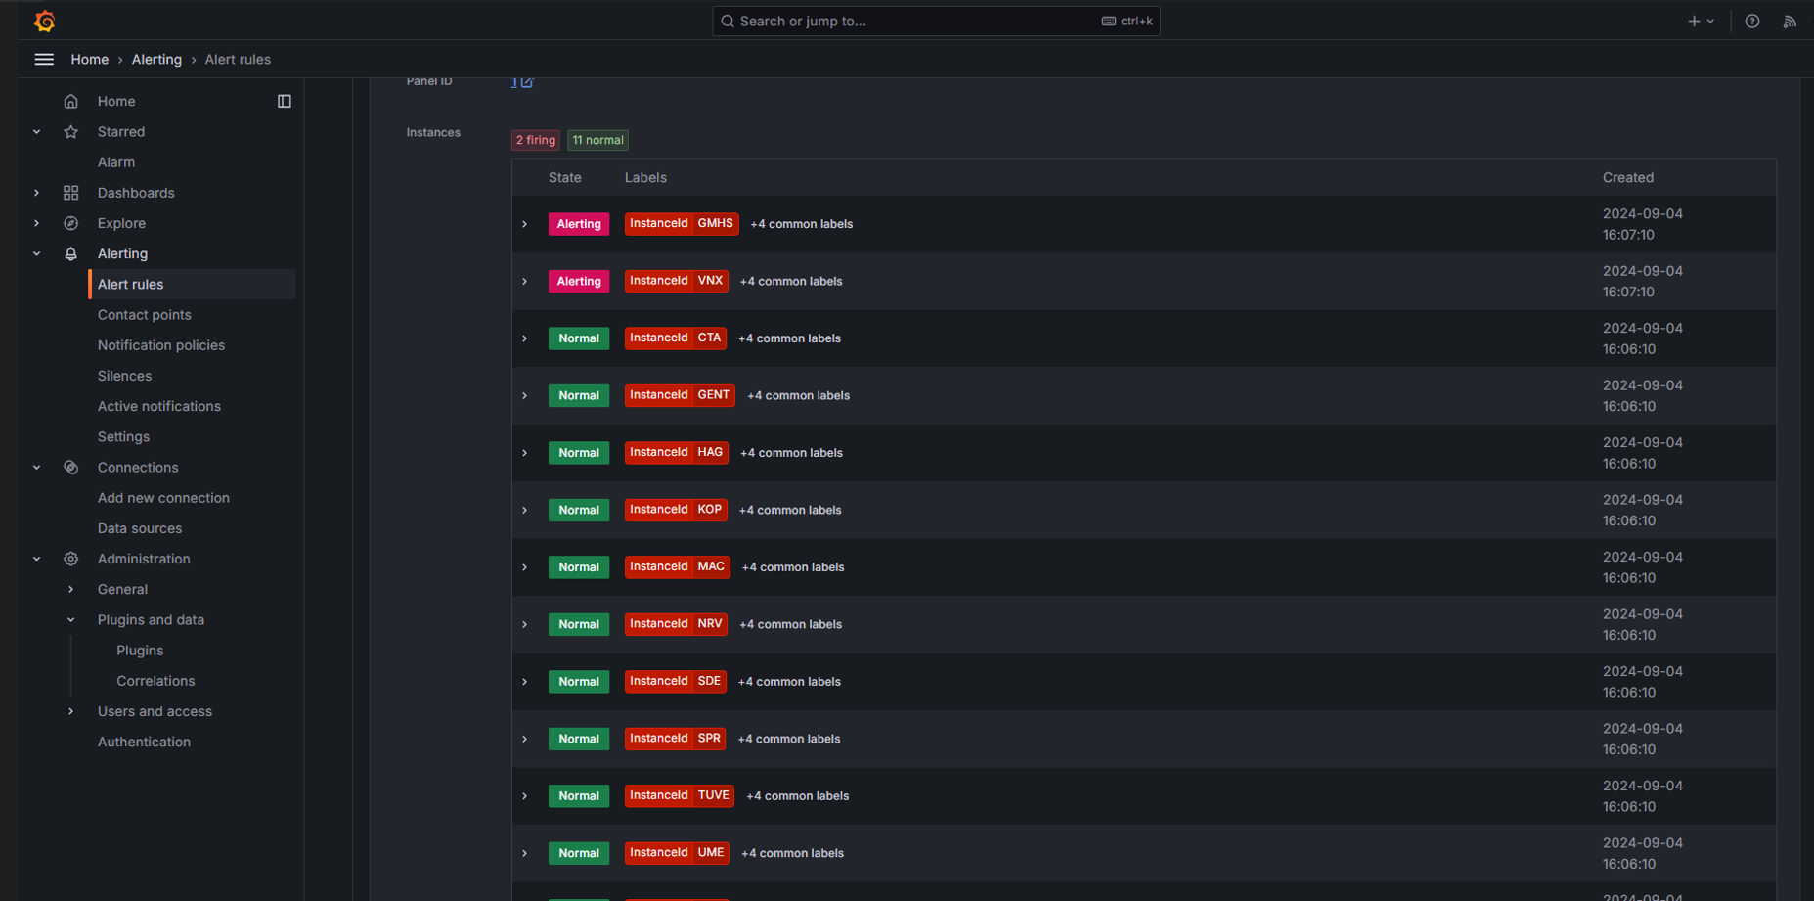

Slide 8
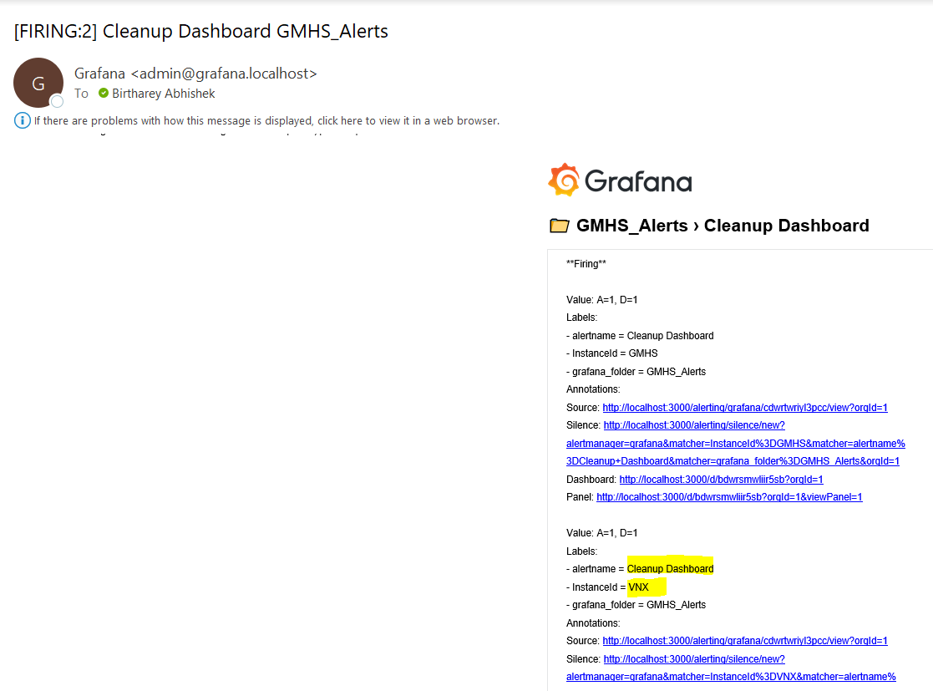
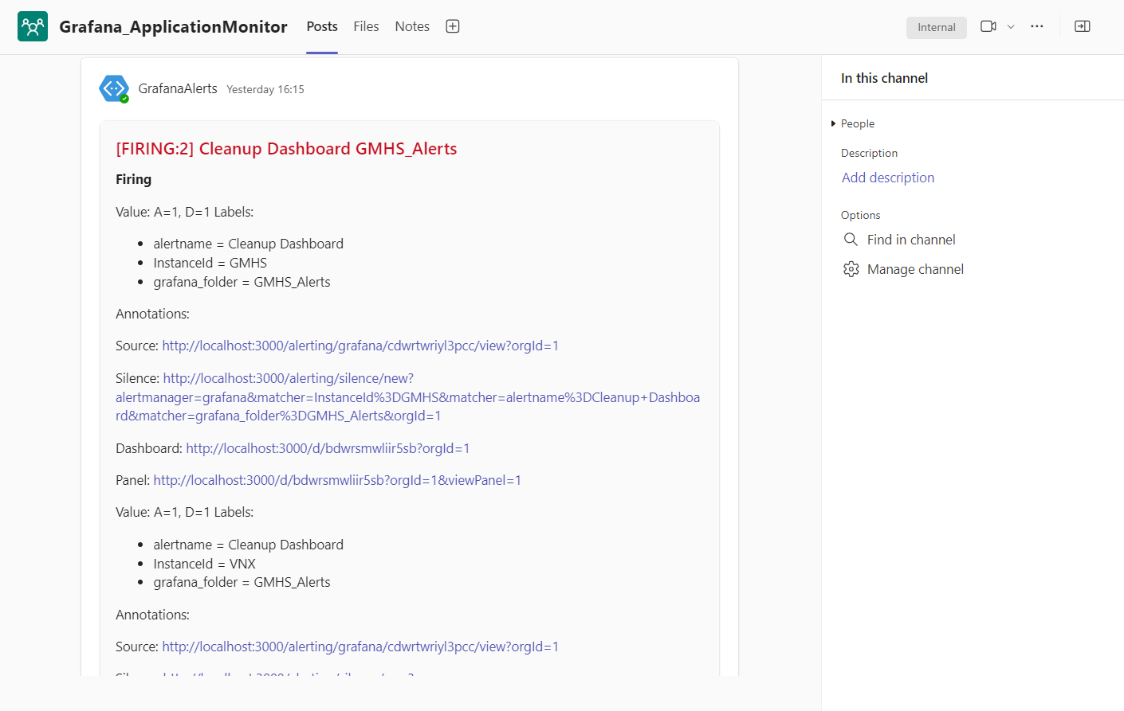
Mail & Teams Alert

Slide 9
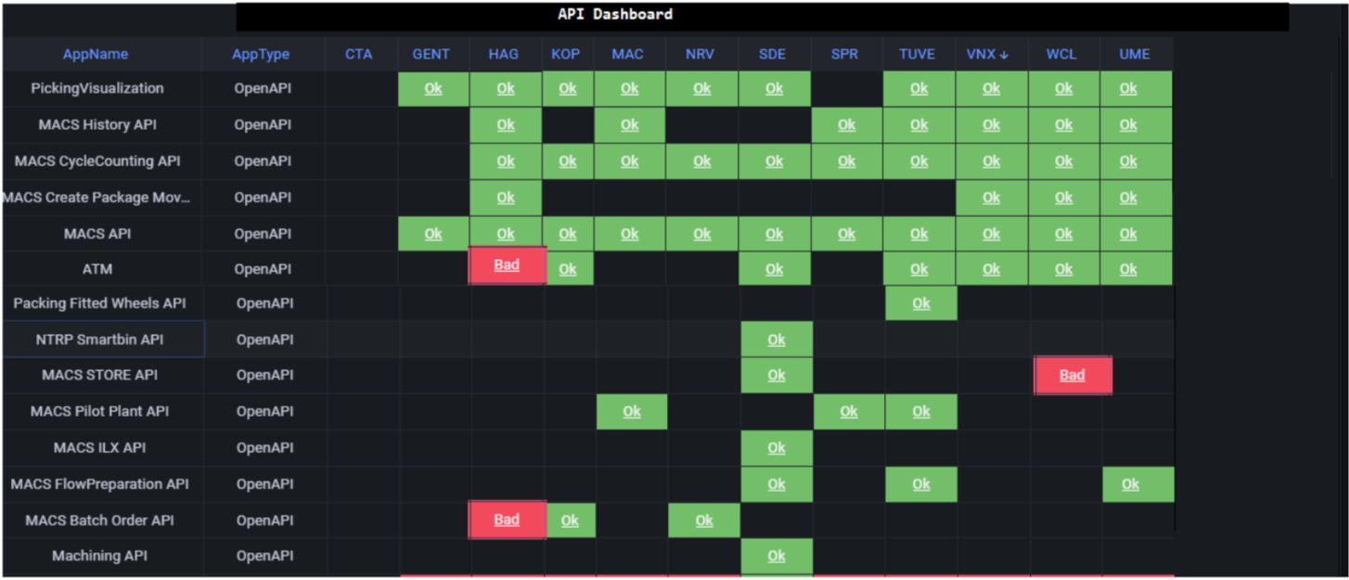
API Health Check Dashboard

Slide 10
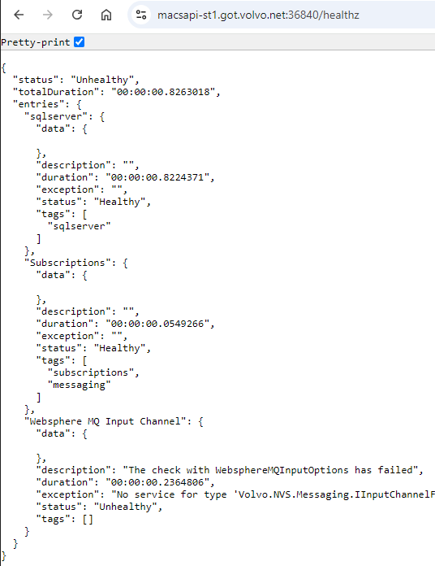
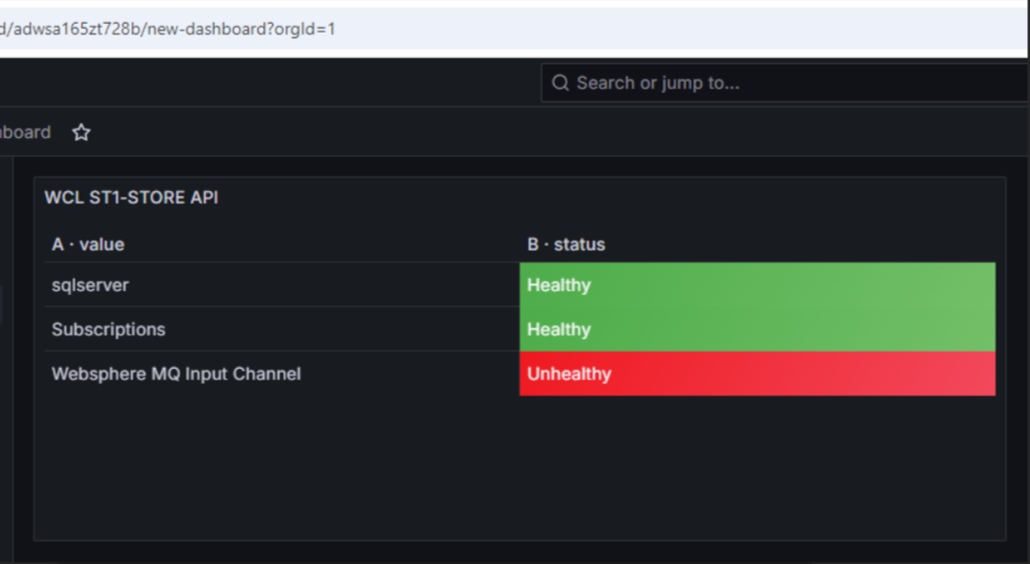
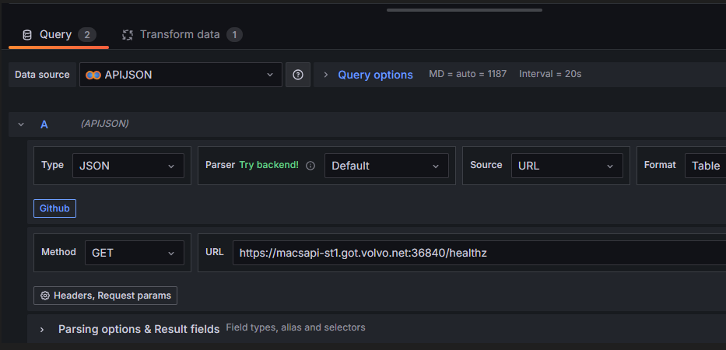

Slide 11
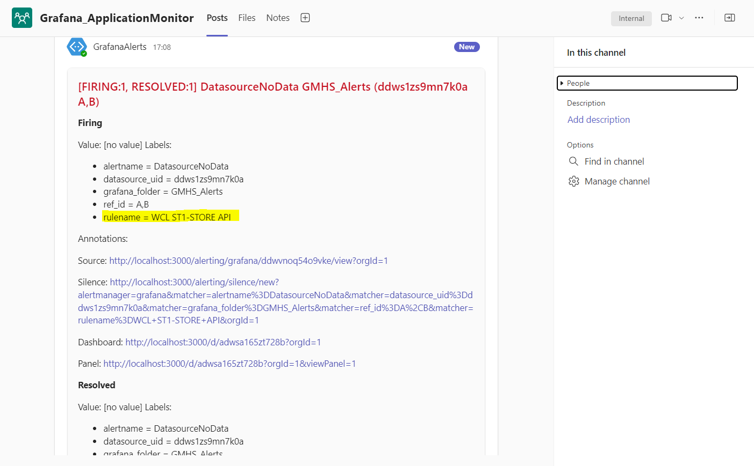

Slide 12

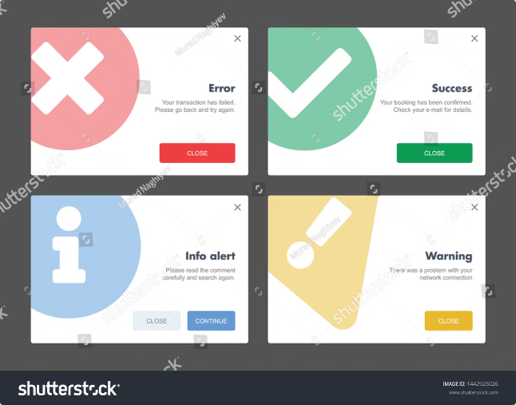
Customizing Alert Content
Parameter
Description
Alert Subject
Customize the subject line for greater clarity.
Alert Message
Format the alert message to include specific data points and context.
Notification Frequency
Control how often alerts are sent, such as once per event or on a recurring schedule.
Alert Severity
Assign severity levels (e.g., Critical, Warning, Info) to prioritize alerts.

Slide 13


Conclusion and Next Steps
Grafana Alerts are an essential tool for proactive monitoring and rapid response to data changes. By effectively configuring alerts and customizing their delivery, you can ensure that your team receives timely notifications and takes prompt action to address potential issues. Explore advanced features like alert grouping, escalation policies, and integration with other monitoring systems to further optimize your alert workflows. Experiment with different notification channels to find the best fit for your team's communication preferences.

